Slide 1






LIBRARY DATABASE
A NALYSIS

Slide 2



01
G.Vishal
02
M.Sai Ram
03
P.Sai Teja
TEAM
MEMBERS

Slide 3









Introduction
PURPOSE:
The goal of this library database analysis is to get a clear picture of how the library is being used. By looking at the data for books, borrowers, and branches, we can find out which books are popular, how active the users are, and how each branch is performing. This helps the library make better decisions about managing books, improving services, and meeting the needs of its users.
TOOLS USED: SQL, CSV , Power Point

Slide 4



📋 Table Descriptions
tbl_publisher: Stores information about book publishers, including their name, address, and phone number.
tbl_book: Contains details of books such as book ID, title, and the publisher name.
tbl_book_authors: Lists authors of each book, linking author names to specific book IDs.
tbl_library_branch :Holds data about each library branch, including its name and address.
tbl_book_copies :Tracks how many copies of each book are available at different branches.
tbl_borrower :Contains information about borrowers, such as their card number, name, address, and phone.
tbl_book_loans :Records book loan transactions, including which book was borrowed, from which branch, by which borrower, and the loan/due dates.

Slide 5




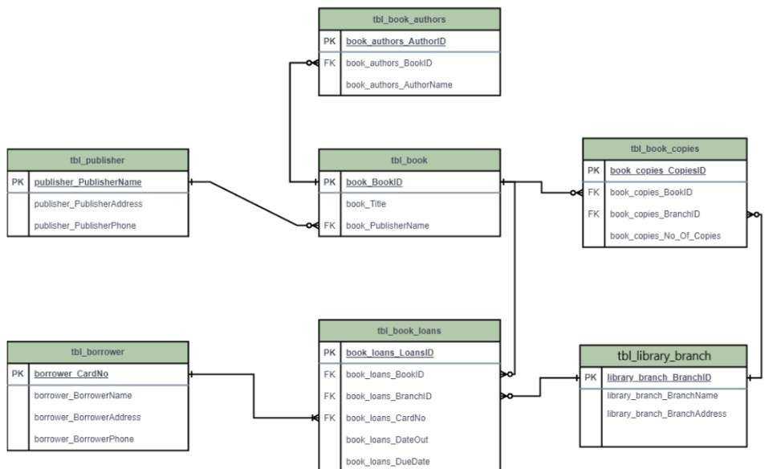
Writing Techniques

Slide 6



PROBLEM STATMENT:
Libraries deal with a lot of information — books, borrowers, branches, and loan records — and managing all of this manually can get messy and inefficient. This project aims to create a simple and organized SQL-based system to help the library keep track of its data, understand how resources are being used, and make better decisions for smoother day-to-day operations.

Slide 7

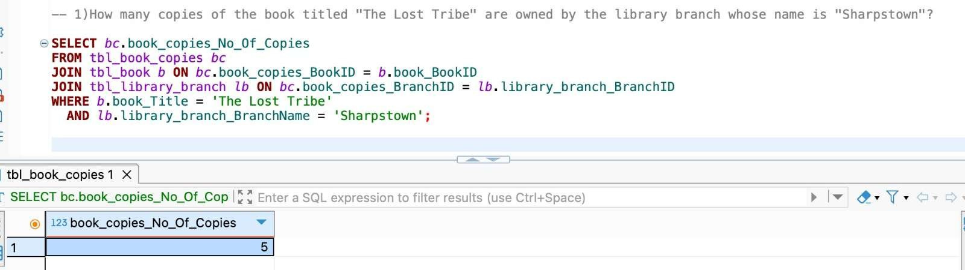



1.How many copies of the book titled "The Lost Tribe" are owned by the library branch whose name is "Sharpstown"?

Slide 8

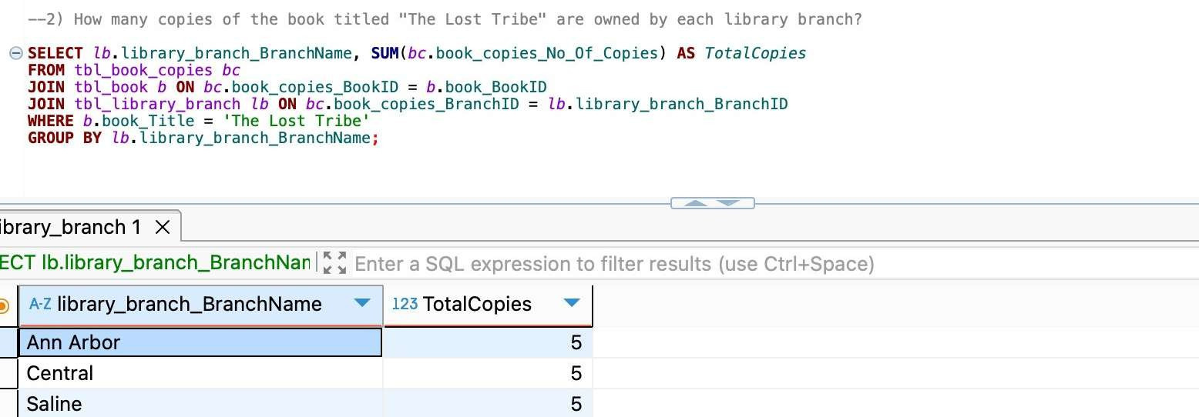



2.How many copies of the book titled "The Lost Tribe" are owned by each library branch?

Slide 9



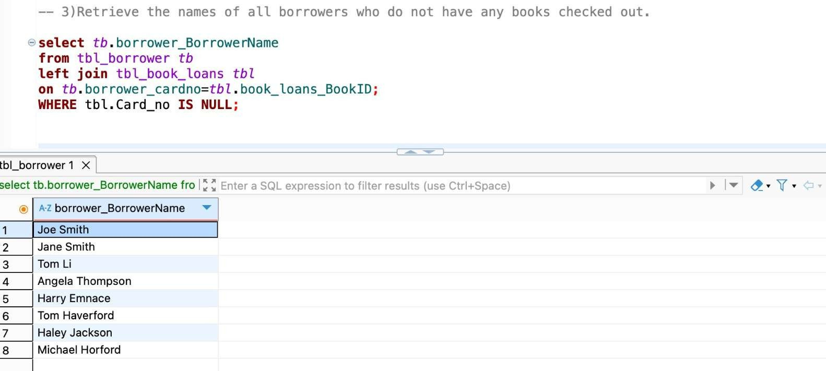


3.Retrieve the names of all borrowers who do not have any books checked out.

Slide 10

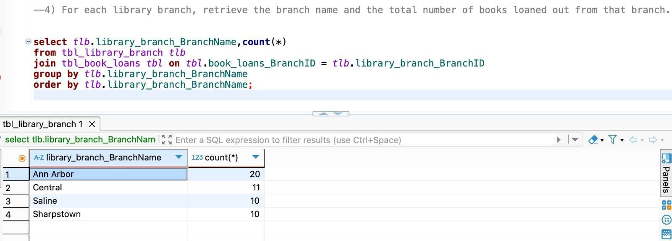


4.For each library branch, retrieve the branch name and the total number of books loaned out from that branch.

Slide 11



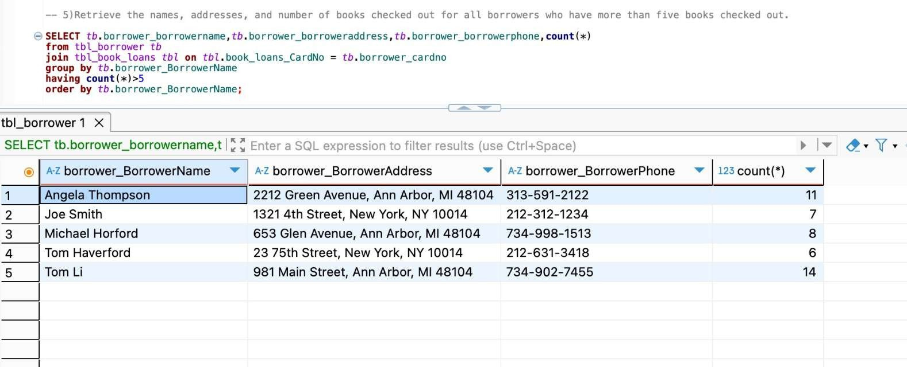


5.Retrieve the names, addresses, and number of books checked out for all borrowers who have more than five books checked out.

Slide 12



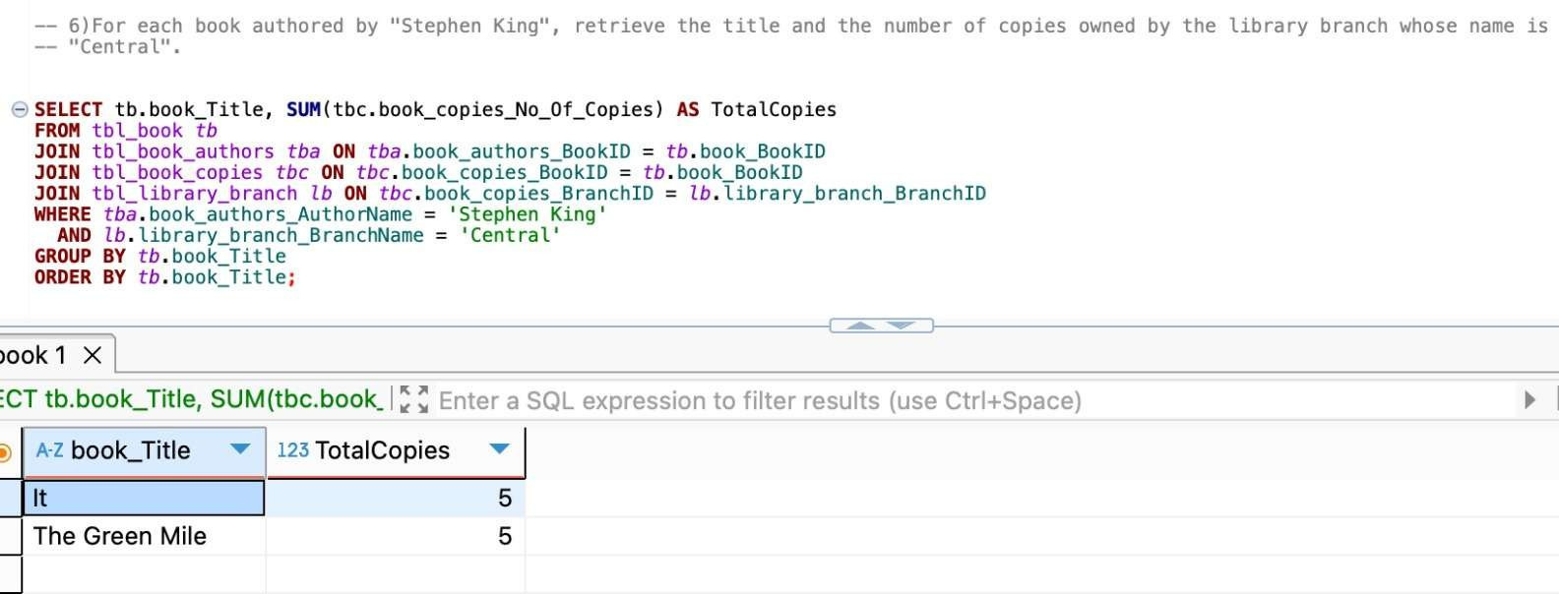
6.For each book authored by "Stephen King", retrieve the title and the number of copies owned by the library branch whose name is "Central".

Slide 13



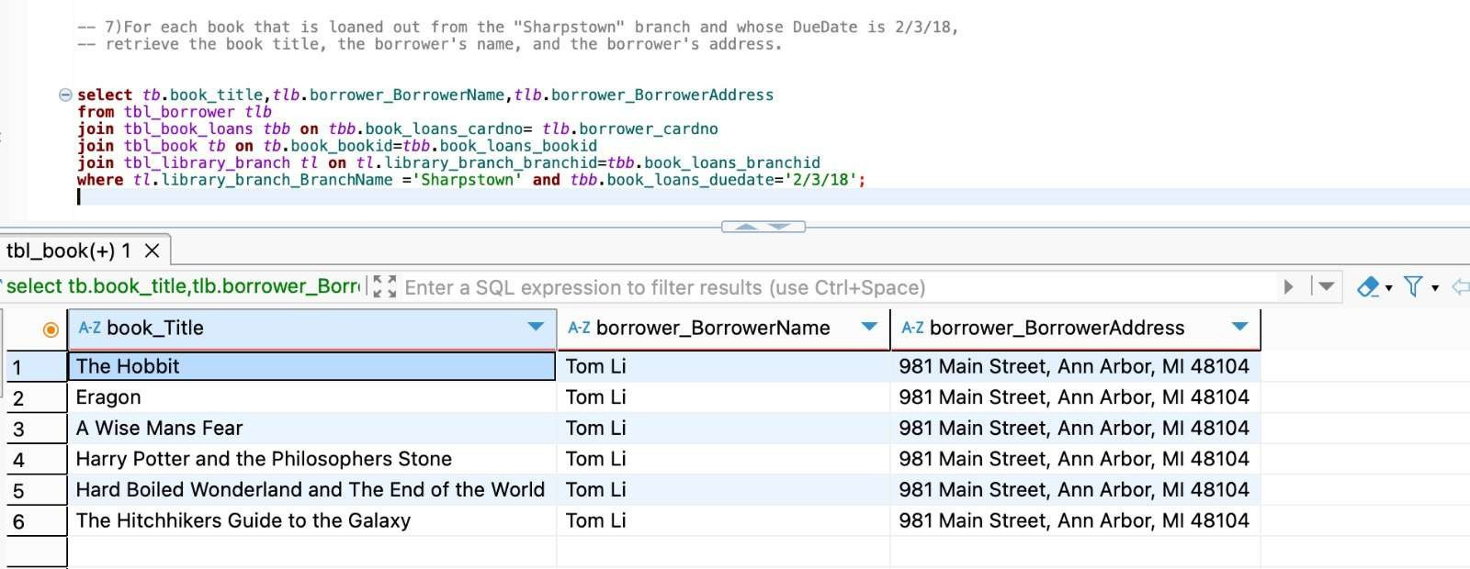


7.For each book that is loaned out from the "Sharpstown" branch and whose DueDate is 2/3/18, retrieve the book title, the borrower's name, and the borrower's address.

Slide 14



CONCLUSION:
This SQL-based library database project successfully organizes and manages key information about books, borrowers, branches, and book loans. Through various queries and analysis, it helps identify borrowing trends, track book availability, and monitor branch performance. Overall, the project improves the efficiency of library operations and provides a strong foundation for making informed decisions to enhance user experience and resource management.

Slide 15






